Slide 1
Holocaust Notes
10 Historical Core Concepts

Slide 2
10 Historical Core Concepts
1. Pre-War Jews
2. Antisemitism
3. Weimar Republic
4. Totalitarian State
5. Persecution
6. U.S. and World Response
7. The Final Solution
8. Resistance
9. Rescue
10. Aftermath

Slide 3
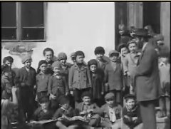
Pre-War
Jew noun /jo͞o/ Jews, plural
A member of the people and cultural community whose traditional religion is Judaism and who trace their origins through the ancient Hebrew people of Israel to Abraham

Slide 4
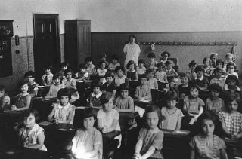
Pre-War
Jews were living in every country in Europe before the Nazis came into power in 1933
Approximately 9 million Jews
Poland and the Soviet Union had the largest populations
Jews could be found in all walks of life: farmers, factory workers, business people, doctors, teachers, and craftsmen

Slide 5
Antisemitism
Jews have faced prejudice and discrimination for over 2,000 years.
Jews were scapegoats for many problems. For example, people blamed Jews for the “Black Death” that killed thousands in Europe during the Middle Ages.

Slide 6
Antisemitism
In the Russian Empire in the late 1800s, the government incited attacks on Jewish neighborhoods called pogroms. Mobs murdered Jews and looted their homes and stores.
Hitler idolized an Austrian mayor named Karl Lueger who used antisemitism as a way to get votes in his political campaign.

Slide 7
Antisemitism
Political leaders who used antisemitism as a tool relied on the ideas of racial science to portray Jews as a race instead of a religion.
Nazi teachers began to apply the “principles” of racial science by measuring skull size and nose length and recording students’ eye color and hair to determine whether students belonged the the “Aryan race.”

Slide 8
Weimar Republic
After Germany lost World War I, a new government formed and became the Weimar Republic.
Many Germans were upset not only that they had lost the war but also that they had to repay (make reparations) to all of the countries that they had “damaged” in the war.

Slide 9
Weimar Republic
The total bill that the Germans had to “pay” was equivalent to nearly $70 billion.
The German army was limited in size.
Extremists blamed Jews for Germany’s defeat in WWI and blamed the German Foreign Minister (a Jew) for his role in reaching a settlement with the Allies.

Slide 10
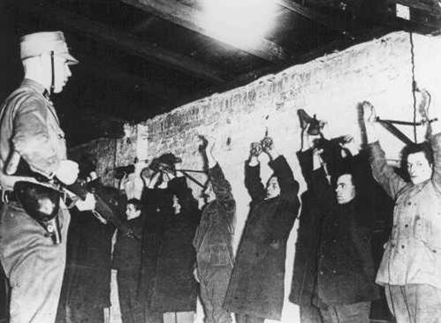
Totalitarian State
Totalitarianism is the total control of a country in the government’s hands
It subjugates individual rights.
It demonstrates a policy of aggression.

Slide 11
Totalitarian State
In a totalitarian state, paranoia and fear dominate.
The government maintains total control over the culture.
The government is capable of indiscriminate killing.
During this time in Germany, the Nazis passed laws which restricted the rights of Jews: including the Nuremberg Laws.

Slide 12
Totalitarian State
The Nuremberg Laws stripped Jews of their German citizenship. They were prohibited from marrying or having sexual relations with persons of “German or related blood.”

Slide 13
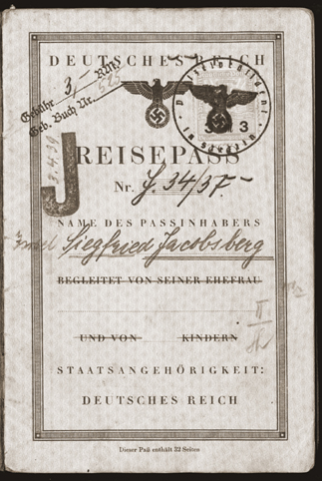
Totalitarian State
Jews, like all other German citizens, were required to carry identity cards, but their cards were stamped with a red “J.” This allowed police to easily identify them.

Slide 14
Totalitarian State
The Nazis used propaganda to promote their antisemitic ideas.
One such book was the children’s book, The Poisonous Mushroom.
Notes:
After presenting this slide, teacher will provide handout with timeline of events during the Totalitarian State.

Slide 15
Persecution
The Nazi plan for dealing with the “Jewish
Question” evolved in three steps:
1. Expulsion: Get them out of Germany
2. Containment: Put them all together in one place – namely ghettos
3. “Final Solution”: annihilation

Slide 16
Persecution
Nazis targeted other individuals and groups in addition to the Jews:
Gypsies (Sinti and Roma)
Homosexual men
Jehovah’s Witness
Handicapped Germans
Poles
Political dissidents
Notes:
Teacher will now instruct and lead students in the “Other Victims” cooperative Learning Activity.

Slide 17
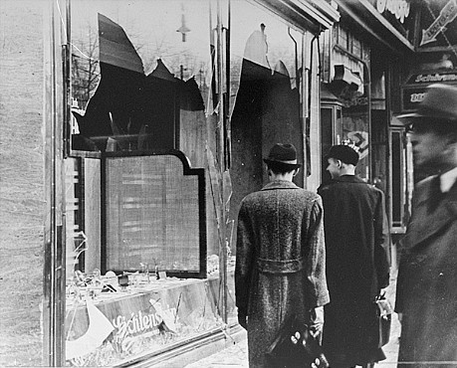
Persecution
Kristallnacht was the “Night of Broken Glass” on November 9-10, 1938
Germans attacked synagogues and Jewish homes and businesses

Slide 18
U.S. and World Response
The Evian Conference took place in the summer of 1938 in Evian, France.
32 countries met to discuss what to do about the Jewish refugees who were trying to leave Germany and Austria.
Despite voicing feelings of sympathy, most countries made excuses for not accepting more refugees.

Slide 19
U.S. and World Response
Some American congressmen proposed the Wagner-Rogers Bill, which offered to let 20,000 endangered Jewish refugee children into the country, but the bill was not supported in the Senate.
Antisemitic attitudes played a role in the failure to help refugees.

Slide 20
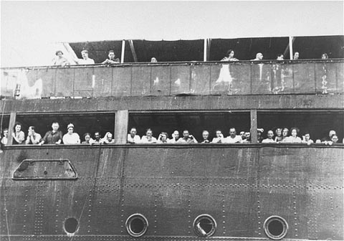
U.S. and World Response
The SS St. Louis, carrying refugees with Cuban visas, were denied admittance both in Cuba and in Florida. After being turned back to Europe, most of the passengers perished in the Holocaust.

Slide 21
Final Solution
The Nazis aimed to control the Jewish population by forcing them to live in areas that were designated for Jews only, called ghettos.
Ghettos were established across all of occupied Europe, especially in areas where there was already a large Jewish population.

Slide 22
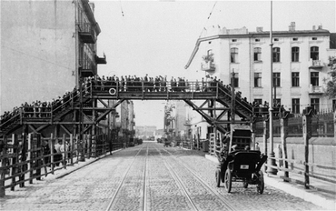
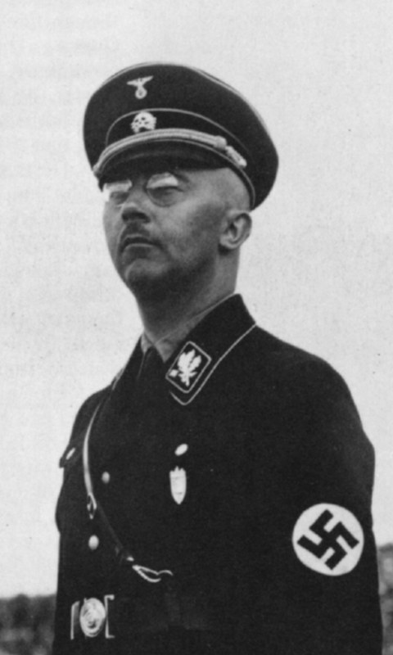
Final Solution
Many ghettos were closed by barbed wire or walls and were guarded by SS or local police.
SS or Schultzstaffel was controlled by Heinrich Himmler.
Jews sometimes had to use bridges to go over Aryan streets that ran through the ghetto.

Slide 23
Final Solution
Life in the ghettos was hard: food was rationed; several families often shared a small space; disease spread rapidly; heating, ventilation, and sanitation were limited.
Many children were orphaned in the ghettos.

Slide 24
Final Solution
Einsatzgruppen were mobile killing squads made up of Nazi (SS) units and police. They killed Jews in mass shooting actions throughout eastern Poland and the western Soviet Union.

Slide 25
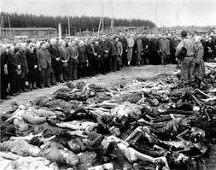
Final Solution
On January 20, 1942, 15 high-ranking Nazi officials met at the Wannsee Conference to learn about how the Jewish Question would be solved.
The Final Solution was outlined by Reinhard Heydrich who detailed the plan to establish death camps with gas chambers.
Notes:
Teacher will now show the clip from “Conspiracy.”

Slide 26
Final Solution
Death camps were the means the Nazis used to achieve the “final solution.”
There were six death camps: Auschwitz-Birkenau, Treblinka, Chelmno, Sobibor, Majdanek, and Belzec.
Each used gas chambers to murder the Jews. At Auschwitz prisoners were told the gas chambers were “showers.”

Slide 27
Final Solution
Most of the gas chambers used carbon monoxide from diesel engines.
In Auschwitz and Majdanek “Zyklon B” pellets, which were a highly poisonous insecticide, supplied the gas.
After the gassings, prisoners removed hair, gold teeth and fillings from the Jews before the bodies were burned in the crematoria or buried in mass graves.

Slide 28
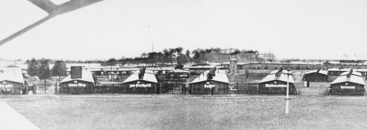
Final Solution
There were many concentration and labor camps where many people died from exposure, lack of food, extreme working conditions, torture, and executions.

Slide 29
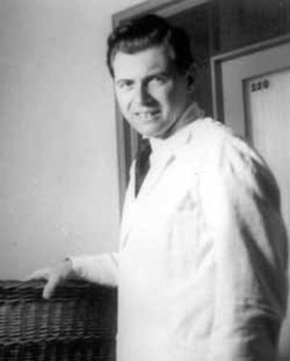
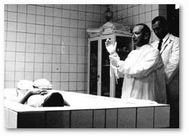
Final Solution
In addition to the poor conditions in the camps, Dr. Josef Mengele, also known as the “Angel of Death,” conducted a “selection” process at Aushwitz where he would select prisoners for medical experiments.

Slide 30
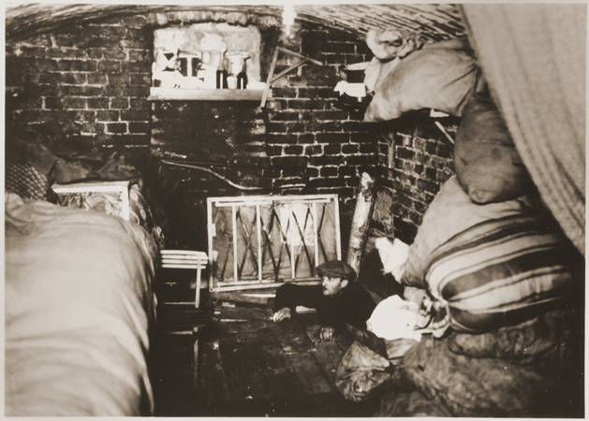
Resistance
Despite the high risk, some individuals attempted to resist Nazism.
The “White Rose” movement protested Nazism, though not Jewish policy, in Germany.

Slide 31
Resistance
The White Rose movement was founded in June 1942 by Hans Scholl, 24-year-old medical student, his 22-year-old sister Sophie, and 24-year-old Christoph Probst.
The White Rose stood for purity and innocence in the face of evil.
In February 1943, Hans and Sophie were caught distributing leaflets and were arrested.
They were executed with Christoph 4 days later.

Slide 32
Resistance
Other famous acts of resistance include:
the Warsaw Ghetto Uprising (Uprising)
Sobibor escape (Escape from Sobibor)
Sonderkommando blowing up Crematorium IV at Birkenau (The Grey Zone)
Jewish partisans who escaped to fight in the forests.

Slide 33
Rescue
Less than one percent of the non-Jewish European population helped any Jew in some form of rescue.
Denmark and Bulgaria were the most successful national resistance movements against the Nazi’s attempt to deport their Jews.

Slide 34
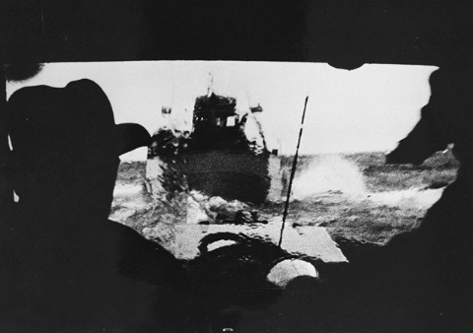
Rescue
In Denmark 7,220 of the 8,000 Jews were saved by ferrying them to neutral Sweden.
The Danes proved that widespread support for Jews could save lives.

Slide 35
Rescue
The War Refugee Board was established by the U.S. Secretary of the Treasury Henry Morgenthau, Jr., and it worked with Jewish organizations, diplomats from neutral countries and European resistance groups to rescue Jews from Nazi-occupied territories.

Slide 36
Rescue
Swedish diplomat Raoul Wallenberg worked in Hungary to protect thousands of Jews by distributing protective Swedish (a neutral country) passports.

Slide 37
Aftermath
Soviet soldiers were the first to liberate camp prisoners on July 23, 1944, at Maidanek in Poland.
British, Canadian, American, and French troops also liberated camp prisoners.
Troops were shocked at what they saw.

Slide 38
Aftermath
Most prisoners were emaciated to the point of being skeletal.
Many camps had dead bodies lying in piles “like cordwood.”
Many prisoners died even after liberation.

Slide 39
Aftermath
Many of the camp prisoners had nowhere to go, so they became “displaced persons” (DPs).
These survivors stayed in DP camps in Germany, which were organized and run by the Allies.
Initially, the conditions were often very poor in the DP camps.

Slide 40
Aftermath
Jewish displaced persons, eager to leave Europe, pushed for the founding of a Jewish state in British-controlled Palestine.
U.S. President Harry Truman issued an executive order allowing Jewish refugees to enter the United States without normal immigration restrictions.

Slide 41
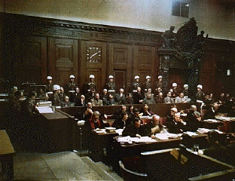
Aftermath
The Nuremberg Trials brought some of those responsible for the atrocities of the war to justice.
There were 22 Nazi criminals tried by the Allies in the International Military Tribunal.
Twelve subsequent trials followed as well as national trials throughout formerly occupied Europe.

Slide 42
Aftermath
The International Military Tribunal took place in Nuremberg, Germany in 1945 and 1946.
12 prominent Nazis were sentenced to death.
Most claimed that they were only following orders, which was judged to be an invalid defense.

Slide 43
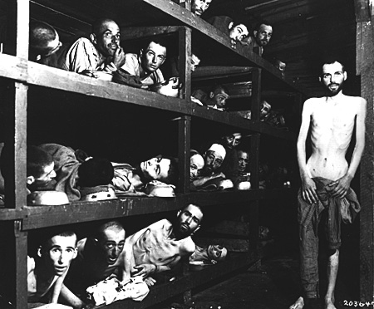
Aftermath
Why study the Holocaust?
Former prisoners of the "little camp" in Buchenwald stare out from the wooden bunks in which they slept three to a "bed." Elie Wiesel is pictured in the second row of bunks, seventh from the left, next to the vertical beam.

Slide 44
Photo Credits
Slide 4-5: #22718 Date: 1930 - 1939 Locale: Sighet, [Transylvania; Baia-Mare] Romania Credit: USHMM, courtesy of Mitchell Eisen Copyright: USHMM – used with permission
Slide 13: #97471 Date: Sep 15, 1923 Locale: Berlin, [Berlin] Germany; Credit: USHMM, courtesy of Margaret Chelnick Copyright: USHMM – used with permission
Slide 16:NARA, College Park, Md.
Slide 17: #25784
Date: Apr 3, 1939 Locale: Stettin, [Pomerania] Germany; Credit: USHMM, courtesy of Walter Jacobsberg Copyright: USHMM – used with permission
Slide 18:#40000 Date: 1938 Locale: Germany Credit: USHMM, courtesy of Lawerence E. Gichner Copyright: USHMM – used with permission
Slide 21:#86838 Date: Nov 10, 1938 Locale: Berlin, [Berlin] Germany Credit: USHMM, courtesy of NARA, College Park Copyright: Public Domain
Slide 24:#11291 Date: Jun 3, 1939 Locale: Havana, Cuba Credit: USHMM, courtesy of NARA, College Park Copyright: Public Domain
Slide 26: #30082 Date: 1941 Locale: Lodz, [Lodz] Poland Credit: USHMM, courtesy of Zydowski Instytut Historyczny Instytut Naukowo-Badawczy Copyright: Public Domain
Slide 28: #19124 Date: Dec 15, 1941 Locale: Liepaja, [Kurzeme] Latvia; Photographer: Carl Strott Credit: USHMM, courtesy of Zentrale Stelle der Landesjustizverwaltungen (Bundesarchiv- A Copyright: Public Domain
Slide 32:#45460 Date: After Apr 27, 1945 Locale: Sachsenhausen, [Brandenburg] Germany Credit: USHMM, courtesy of Gedenkstatte und Museum Sachsenhausen Copyright: Public Domain
Slide 33: #26559 Date: Apr 19, 1943 - May 16, 1943 Locale: Warsaw, Poland; Varshava; Warschau Credit: USHMM, courtesy of NARA, College Park Copyright: Public Domain
Slide 37: #62191 Date: 1943 Locale: Sweden Credit: USHMM, courtesy of Frihedsmuseet Copyright: Public Domain
Slide 39: Copyright USHMM – used with permission
Slide 41: #74607 Date: Apr 16, 1945 Locale: Buchenwald, [Thuringia] Germany Credit: USHMM, courtesy of NARA, College Park Copyright: Public Domain
Slide 44: #61330 Date: Nov 20, 1945 - Oct 1, 1946 Locale: Nuremberg, [Bavaria] Germany Credit: USHMM, courtesy of NARA, College Park Copyright: Public Domain
Slide 46: #74607 Date: Apr 16, 1945 Locale: Buchenwald, [Thuringia] Germany Credit: USHMM, courtesy of NARA, College Park Copyright: Public Domain

Slide 45
“Not only the Jews” Poster Project
Research other individuals and groups Nazis targeted in addition to the Jews:
Gypsies (Sinti and Roma)
Jehovah’s Witness
Handicapped Germans
Poles
Political dissidents
Notes:
Teacher will now instruct and lead students in the “Other Victims” cooperative Learning Activity.

